Slide 1


Parth Gandhi
December 15, 2022

Slide 2

Outline
Executive Summary
Introduction
Methodology
Results
Conclusion
Appendix

Slide 3
Executive Summary
Methodology
Data Collection – Using Web Scraping and SpaceX API
EDA – Using Data Wrangling and Interactive Data Visualization
Predictive Analytics – Using ML Models (with10-fold CV and 20% Test Data): LogReg, SVM, DTs, and KNN Classifiers
Results Summary
EDA Helped Identify Features That Were Best To Predict The Success of Launches
A Comparison of Machine Learning Predictions Showed The Most Accurate Model to Predict The Success of Launches Using The Pre-Identified Features Using EDA
Although All The Model Had The Same Test Accuracy, DTs Had a Higher Accuracy on Training Data

Slide 4
Introduction
Background
Space Y Needs to Evaluate Its Viability to Compete With Space X
This Can Be an Indirect Insight From Whether Space Y Can Launch and Successfully Land First Stage Rockets At a Lower Total Cost
For This, Space Y Needs to Know What Factors Correctly Predict Successful Landings, Which Can be Found From The Space X Data Available
Using This Information On Predictive Variables of a Successful Stage 1 Launch, Space Y can Optimize Them (For Ex. Launch Location, Payload Mass, etc.) And Reduce The Total Cost Per Launch
Problems you want to find answers
What Factors Affect The Successful Landing of Stage 1 Rocket?
Which ML Model/s Can be Used To Predict a Successful Outcome?
What Value of the Identified Factor/s Will Optimize The Cost of Launches?

Slide 5

Section 1

Slide 6
Methodology
Executive Summary
Data collection methodology:
Data from Space X was obtained from 2 sources
Space X API – https://api.spacexdata.com/v4/rockets/
WebScraping – https://en.Wikipedia.org/wiki/List_of_Falcon/_9/_and_Falcon_Heavy_launches
Perform data wrangling
Dealing with missing values – imputing with mean
Categorical variables converted to numerical using One Hot Encoding
Created a landing outcome label based on outcome data after Feature selection process

Slide 7
Methodology
Executive Summary
Performed exploratory data analysis (EDA) using visualization and SQL
Perform interactive visual analytics using Folium and Plotly Dash
Perform predictive analysis using classification models
The data was normalized using standard feature scaling
Then the data was split into 20% test data and 80% training data
The training data was now used to evaluate the accuracy of 4 classifiers – LogReg, SVM, DT, and KNN along with 10-fold CV and Grid Search to optimize the hyperparameters

Slide 8
Data Collection
Data from Space X was obtained from 2 sources:
Space X API – https://api.spacexdata.com/v4/rockets/
WebScraping – https://en.Wikipedia.org/wiki/List_of_Falcon/_9/_and_Falcon_Heavy_launches

Slide 9
Data Collection – SpaceX API
Request API and Parse the Space X launch data using the GET request, as JSON
Convert to a Pandas DF using .json_normalize()
Filter Data to Include only Falcon 9 launches
Deal with missing values
Retrieve Columns Data for Specific Columns
SpaceX offers a public API – Data for Falcon 9 Launches can be obtained form here
See the flowchart for using this API to collect the Data
GitHub URL –https://github.com/parthgandhi1998/testrepo/blob/master/Module_1.1_spacex-data-collection-api.ipynb

Slide 10
Data Collection - Scraping
Data for Space X launches can also be downloaded from Wikipedia
See the flowchart for using Web Scraping to collect the Data
GitHub URL – https://github.com/parthgandhi1998/testrepo/blob/master/Module_1.2_Data%20Collection%20Using%20Webscraping.ipynb
Request the Falcon9 Launch Wiki page from its URL
Extract all column/variable names from the HTML table header
Create a data frame by parsing the launch HTML tables

Slide 11
Data Wrangling
Create Landing Outcome Label
Exploratory Data Analysis was performed to for understanding the variables and identifying feature information.
Calculated Number of Launches on Each site, number and occurrences of each orbit, and the number and occurrence of mission outcome per orbit type
Created a landing outcome label from the Outcome column
GitHub URL – https://github.com/parthgandhi1998/testrepo/blob/master/Module_1.3_Data%20Wrangling.ipynb
EDA
Data Exploration and Feature Understanding
Summary
Metrics – Site, orbit, and mission outcome
Create Landing Outcome Label
Using the Outcome label

Slide 12
EDA with Data Visualization
For EDA, Scatter plots and Bar plots were used to visualize the relationships between different pairs of features
Payload Mass Vs Flight Number
Launch Site Vs Flight Number
Launch Site Vs Payload Mass
Orbit Vs Flight Number
Payload Vs Orbit
GitHub URL - https://github.com/parthgandhi1998/testrepo/blob/master/Module_2.2_EDA_with_Pandas_and_Matplotlib.ipynb

Slide 13
EDA with SQL
The SQL queries for the following tasks were performed:
Display the names of the unique launch sites in the space mission
Display 5 records where launch sites begin with the string 'CCA'
Display the total payload mass carried by boosters launched by NASA (CRS)
Display average payload mass carried by booster version F9 v1.1
List the date when the first successful landing outcome in ground pad was achieved.
List the names of the boosters which have success in drone ship and have payload mass greater than 4000 but less than 6000
List the total number of successful and failure mission outcomes
List the names of the booster_versions which have carried the maximum payload mass. Use a subquery
List the records which will display the month names, failure landing_outcomes in drone ship ,booster versions, launch_site for the months in year 2015.
Rank the count of successful landing_outcomes between the date 04-06-2010 and 20-03-2017 in descending order.
GitHub URL –
https://github.com/parthgandhi1998/testrepo/blob/master/Module_2.1_EDA%20with%20SQL.ipynb

Slide 14
Build an Interactive Map with Folium
Map objects such as markers, circles, lines, and marker clusters were created and added to a folium map
Markers indicate points like launch sites
Circles indicate highlighted areas around specific coordinates and add a label to it, like NASA Johnson Space Center
Marker cluster is a collection of multiple marker objects layered into a single marker cluster object to display multiple launch sites
Lines are for showing distances between two coordinates
GitHub URL - https://github.com/parthgandhi1998/testrepo/blob/master/Module_3.1_Interactive%20Visual%20Analytics%20with%20Folium.ipynb

Slide 15
Build a Dashboard with Plotly Dash
The following graphs and plots were used to visualize the data:
Percentage of launches by site
Payload range – Range Slider
This comparison helped identify the relation between payloads and launch sites, and thus decide the best place to launch according to payloads
GitHub URL - https://github.com/parthgandhi1998/testrepo/tree/master/Module_3.2_Interactive%20Dashboard%20with%20Plotly%20Dash

Slide 16
Predictive Analysis (Classification)
Predictive Analytics – Using ML Models (with10-fold CV and 20% Test Data): LogReg, SVM, DTs, and KNN Classifiers (Using Grid Search to optimize hyperparameters)
GitHub URL - https://github.com/parthgandhi1998/testrepo/blob/master/Module_4.1_SpaceX_Machine_Learning_Prediction.ipynb
Data preparation and standardization
Model testing
Comparing model accuracy
Split data – 80:20% train:test
10-fold CV, Grid search for Hyperparameter tuning
Model training

Slide 17
Results
Exploratory data analysis results
Space X uses 4 different launch sites
The first launches were done to Space X itself and NASA
The average payload of F9 v1.1 booster is 2,928.4 kg
The first success landing outcome happened in 2015, five years after the first launch
Many Falcon 9 booster versions were successful at landing in drone ships having payload above the average
Almost 100% of mission outcomes were successful
Two booster versions failed at landing in drone ships in 2015: F9 v1.1 B1012 and F9 v1.1 B1015
The success rate kept improving since 2013 till 2020

Slide 18
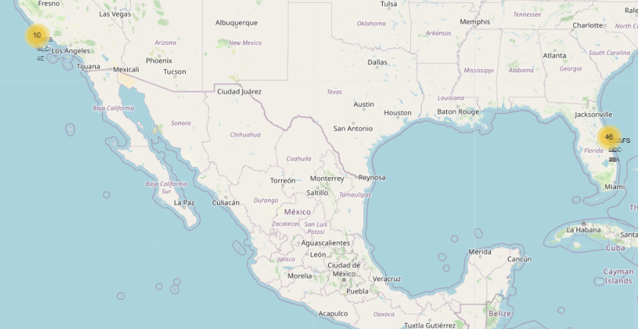
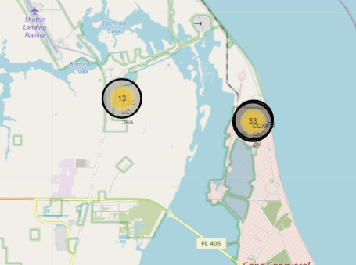
Results
Interactive analytics showed that launch sites are strategically placed close to the equator and near to safety places – ex. Sea, and have a good logistics infrastructure around them
Most launches happen at the east coast launch sites (Assuming due to their proximity to the equator)

Slide 19
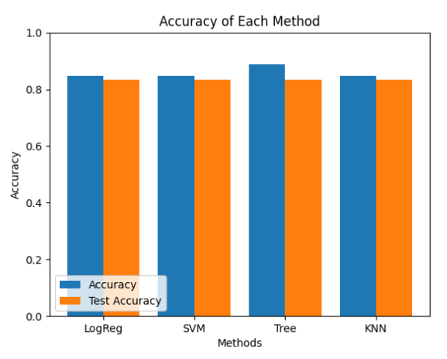
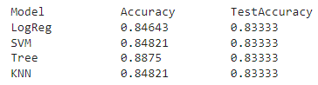
Results
Predictive analysis results
Predictive Analysis showed that Decision Tree Classifier is the best model to predict successful landings, having accuracy over 87% and accuracy for test data over 94%.

Slide 20

Section 2

Slide 21
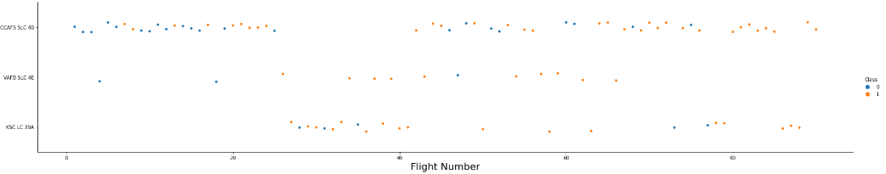
Flight Number vs. Launch Site
Scatter plot of Flight Number vs. Launch Site
CCAF5 SLC 40 seems to be a successful launch site considering more recent years.
This is followed by VAFB SLC 4E and KSSC LC 39A
The general success rate has increased with time

Slide 22
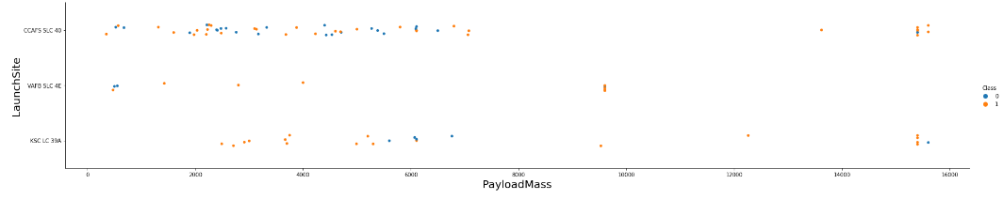
Payload vs. Launch Site
Scatter plot of Payload Vs Launch Site
There are fewer payloads above 9000 Kgs, but have a very high success rate
Payloads over 12,000kg seems to be possible only on CCAFS SLC 40 and KSC LC 39A launch sites.
VAFB SLC 4E has never launched a payload of more than 10000 Kgs and KSSC LC 39A has never launched a payload less than 2000 Kgs

Slide 23
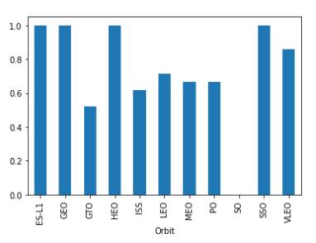
Success Rate vs. Orbit Type
Highest success rate (=1) are for the orbits-
ES-L1
GEO
HEO
SSO
Followed by -
VLEO (>80%)
LFO (>70%)
SO has no successful launches, and the lowest success rate is about 50% for GTO

Slide 24
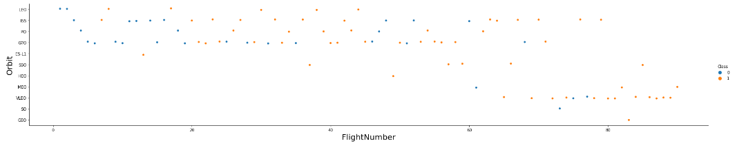
Flight Number vs. Orbit Type
Scatter plot of Flight number vs. Orbit type
More recently, the trend has shifted towards VLEO considering the frequency of launches
The success rate has increased over time in all orbits

Slide 25
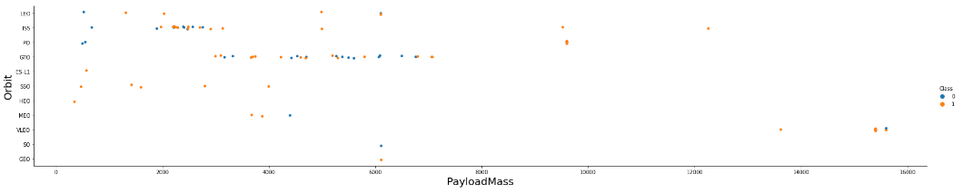
Payload vs. Orbit Type
Scatter plot of payload vs. orbit type
There has been only one launch each to SO and GEO orbits
Majority of the payloads have been launched to GTO and ISS
ISS has the widest range of payloads and a good success rate as well

Slide 26
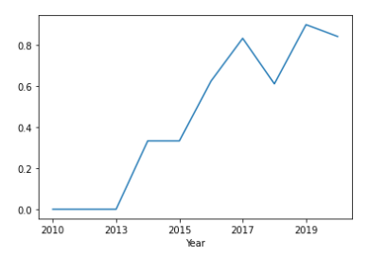
Launch Success Yearly Trend
The success rate kept increasing from 2013 till 2020
The initial 3 years showed no growth however the improvement took place in a step-wise fashion bi-yearly, seeing a dip in 2018 before climbing up again in 2019-2020

Slide 27
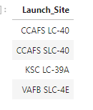
All Launch Site Names
There are 4 unique launch sites
They are obtained by selecting unique occurrences of “launch_site” values from the dataset.

Slide 28
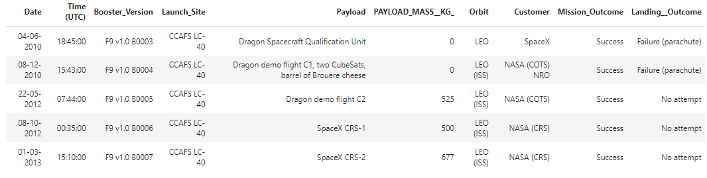
Launch Site Names Begin with 'CCA'
5 records where launch sites begin with `CCA`
These are the 5 launches from Cape Canaveral

Slide 29
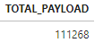
Total Payload Mass
Total payload carried by boosters from NASA
• Total payload calculated above, by summing all payloads whose codes contain ‘CRS’, which corresponds to NASA.

Slide 30
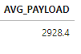
Average Payload Mass by F9 v1.1
Avg payload mass carried by booster version F9 v1.1
Filtering data by the booster version above and calculating the average payload mass we obtained the value of 2,928.4 kg.

Slide 31
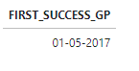
First Successful Ground Landing Date
Dates of the first successful landing outcome on ground pad
By filtering data by successful landing outcome on ground pad and getting the minimum value for date it’s possible to identify the first occurrence, that happened on 12/22/2015.

Slide 32
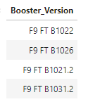
Successful Drone Ship Landing with Payload between 4000 and 6000
Names of boosters which have successfully landed on drone ship and had payload mass greater than 4000 but less than 6000
Selecting distinct booster versions according to the filters above, these 4 are the result.

Slide 33
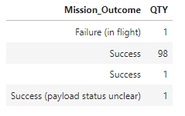
Total Number of Successful and Failure Mission Outcomes
Total number of successful and failure mission outcomes
Grouping mission outcomes and counting records for each group led us to the summary above

Slide 34
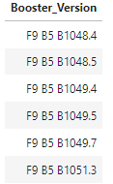
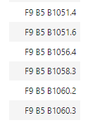
Boosters Carried Maximum Payload
Names of the booster which have carried the maximum payload mass
These are the boosters which have carried the maximum payload mass registered in the dataset.

Slide 35
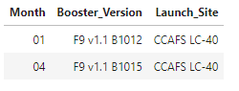
2015 Launch Records
Failed landing_outcomes in drone ship, their booster versions, and launch site names for in year 2015
These were the 2 failed landings for the year 2015

Slide 36
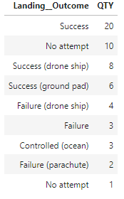
Rank Landing Outcomes Between 2010-06-04 and 2017-03-20
Ranking of landing outcomes (such as Failure (drone ship) or Success (ground pad)) between the date 2010-06-04 and 2017-03-20, in descending order
The classification of outcomes shows the types other than failure and success to consider, like No attempt and Controlled (ocean)

Slide 37

Section 3

Slide 38
All Launch Sites
Launch sites are near to the sea and equator largely.
They are not too far from roads and railroad for logistic conveniences.

Slide 39
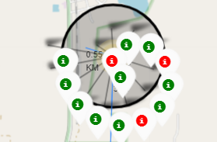
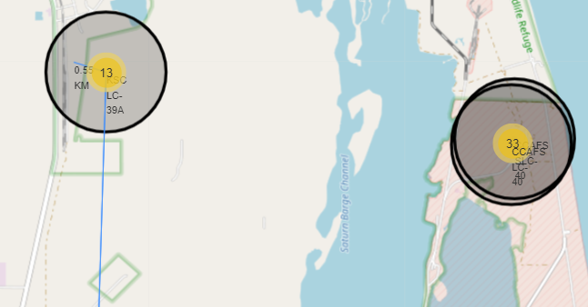
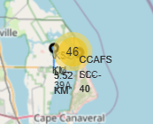
Launch Outcome by Site
Example of KSC LC-39A launch site launch outcomes

Slide 40
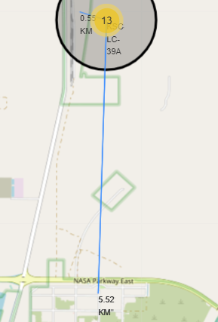
Logistics and Safety
Launch site KSC LC-39A has good logistics aspects, being near railroad and road and relatively far from inhabited areas.

Slide 41

Section 4

Slide 42
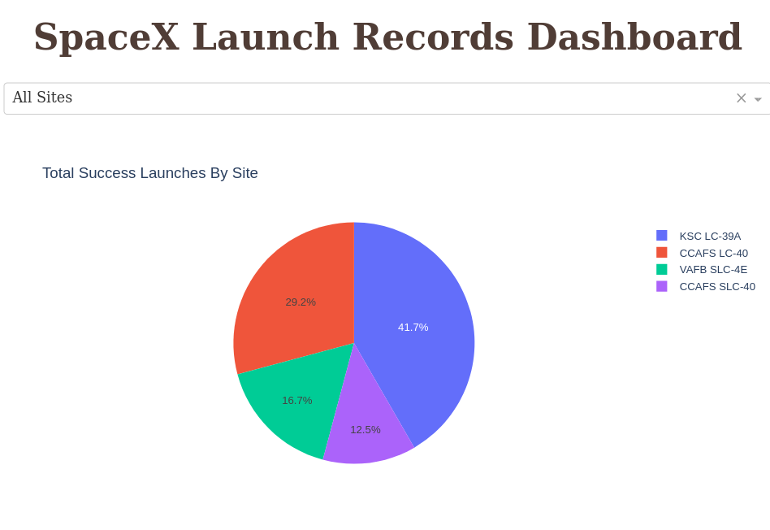
Successful Launches by Site
The launch site greatly influences the success of missions, with KSC LC-39A having the highest share of successful launches i.e. 41.7%

Slide 43
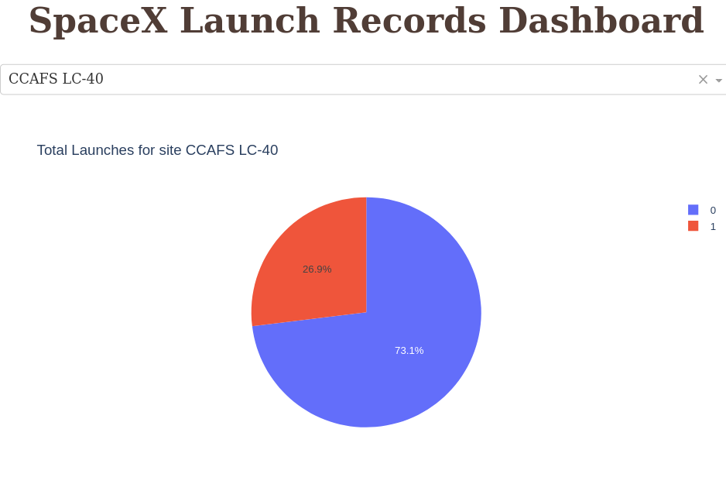
Launch Success Ratio for KSC LC-39A
76.9% of launches are successful on this site

Slide 44
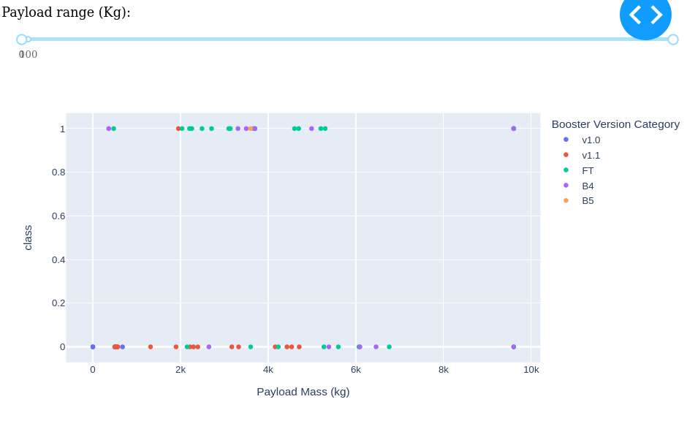
Payload vs. Launch Outcome
Payloads under 6,000kg and FT boosters are the most successful combination.

Slide 45
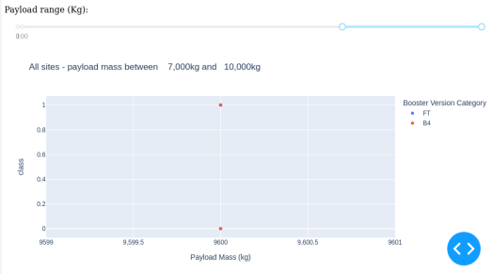
Payload vs. Launch Outcome
Not enough data to estimate the risk of launches over 7000 Kgs

Slide 46

Section 5

Slide 47
Classification Accuracy
4 ML models were tested, and their accuracies are plotted in the bar graph-
Predictive Analysis showed that Decision Tree Classifier is the best model to predict successful landings, having accuracy over 87% and accuracy for test data over 94%.

Slide 48
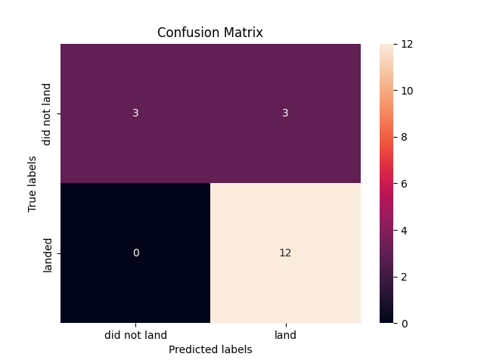
Confusion Matrix
Confusion matrix of Decision Tree Classifier proves its accuracy by showing a high value for true positive and true negative compared to the false ones.

Slide 49
Conclusions
The launch sites are located near the coast and equator, and are close to rail/road/air ways for logistic conveniences
The best launch site according to success rates is KSC LC-39A. However, CCAF5 SLC 40 seems to be more successful launch site considering more recent years.
Payloads under 6,000kg and FT boosters are the most successful combination.
Most mission outcomes are successful, and the success rate of launches has kept increasing over time – which explains the technological advancements (better rockets and processes) and a better understanding of factors affecting the launch outcomes
Decision Trees Classifier can be used to predict successful landings and increase profits by cutting on the cost of stage 1 rockets.

Slide 50
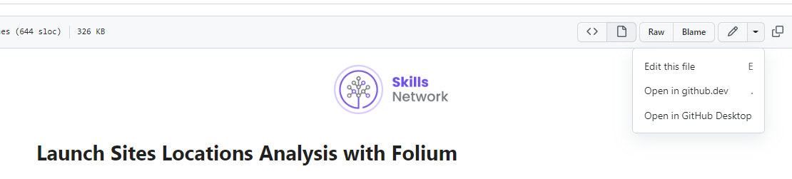
Appendix
np.random.seed must be used while using ML models for reproducibility.
Folium maps can be viewed by opening the notebook in ‘github.dev’ option

Slide 51


